Slide 1
Driver drowsiness detection via steering monitoring

Slide 2
Motivations
Attempt to reduce road accidents caused by driver drowsiness
Attempt to detect early signs of microsleep episodes before a loss-of-control
demonstrate a non-intrusive drowsiness detection approach that requires no additional sensors (camera, EEG, etc.) beyond the steering input

Slide 3
Data generation
Data generation for this problem is the most important step given the fact that publicly data available is scarce and mostly not open

Slide 4
Data Generation #1st attempt autopilot + artificial sabotage
Alert state = CARLA autopilot; Drowsy = autopilot + perturbation injected on steering
White noise: Random jitter on steer
Sinusoidal drift: low frequency oscillation
Random freezes: Zero input for N steps
Problem: noise painted on “kind of good steering”. Classifier just learns “autopilot vs autopilot+noise”. The baseline doesn’t have anything to do with human driving

Slide 5
Data Generation #2nd attempt Reinforcement Learning
Train two PPO agents: one for the alert driving, one for drowsy driving
Alert Agent: Standard lane-keeping reward
Drowsy Agent: reward design ????
Problem: Drowsy reward is non-trivial, if you just invert the reward, the driving becomes chaotic , not drowsy.

Slide 6
Data Generation #3rd attempt Human Driving (what i used)
Same person drives alert and drowsy, the signal is real
Mouse steering: Continuous signal
Town04 highway: Monotony leads to drowsiness
Feature correctness: Features move in literature predicted directions.
Problem: Not a good statistical test, the population is just 1, it is not a realistic study

Slide 7
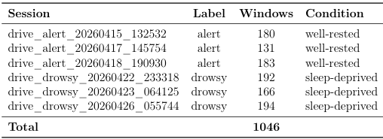
Data generation

Slide 8
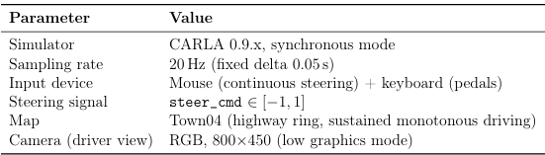
Data acquisition

Slide 9
Feature extraction
Windowing: The continuous steering signal is sliced into fixed-length windows of 15 seconds (300 samples at 20Hz) with 75% overlap (steps of 2s)
balances temporal resolution against window length: 15 seconds is long enough to capture a full drift-then correct cycle,while the high overlap maximises the number of training examples from limited session data.

Slide 10
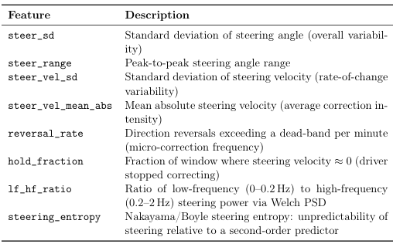
Feature extraction steering features

Slide 11
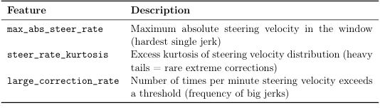
Feature extraction steering features

Slide 12
Classification Model
Logistic regression (with standardised features and balanced class weights) as the interpretable baseline. Its coefficients directly indicate which steering features contribute to drowsiness and in which direction.
Random forest (300 trees, max depth 4, min samples leaf 3, balanced subsample weighting) as a capacity-limited ensemble.
Deep learning approaches (LSTMs, 1D-CNNs) were deliberately avoided. With approxi mately 1000 correlated windows from a single subject, a neural network would memorise the subject and session rather than learning drowsiness.

Slide 13
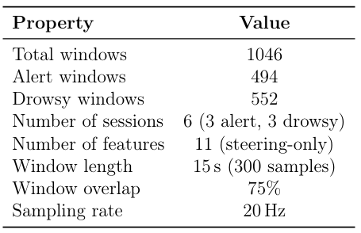
Dataset

Slide 14
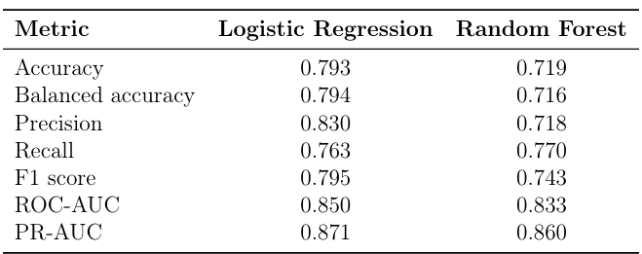
Benchmark

Slide 15
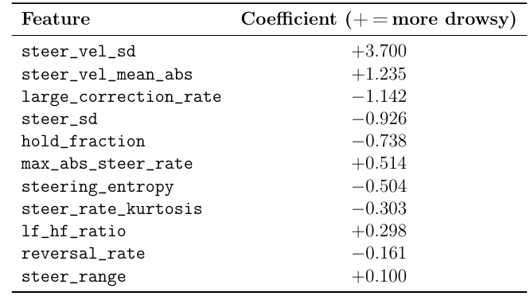
Feature analysis

Slide 16
The drowsiness detection system
Steering inactivity detector : checked every tick at 20Hz. If the steering has barely moved for more than 3 seconds.
ML-confirmerd drowsiness: logistic regression model run on a rolling windows of 15s every 2 seconds: High confidence bypass, if a single prediction yields a probability over .80 the warning fires immediately without majority vote. Otherwise for borderline predictions between 0.5 to 0.8 a majority vote over 2 consecutive predictions.

